Slide 1

Computing GCSE CA
Task 3 - A453 – ISBN Code Generator
Kenneth Cajigas

Slide 2

Introduction

Slide 3
Task 2 Requirements
A data file will be supplied for this task.
A simple address book system holds names, addresses and telephone numbers for friends and family and business contacts. The system stores:
a surname and first name
two lines of the address and a post code
a telephone number
date of birth
email address.
Create a program to search this data file:
by surname to retrieve and display the details for a contact
by date of birth to retrieve and display all contacts with a birthday in a particular month.

Slide 4
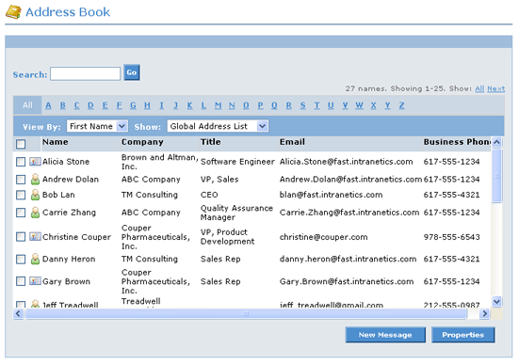
What is an address book?
An address book is a file where a list of names, addresses, work places, phone numbers, email addresses
It can be in any type of file form, such as in a book, on a computer
An address book typically holds information such as peoples names, address’s, phone numbers etc. Here is an example:
In this task, the address book is provided in the form of a .csv file, with the information of people’s DOB, First Name, Last Name, Phone Number, Address.

Slide 5
Group discussion
In our group discussion, we discussed the requirements of the address book search. We all agreed that:
The program would have to check the casing in the input the user enters (make it case insensitive)
The task would provide a .csv file, where the program would have to open and read from it
The user would be able to enter a date, and the program would return results if any are found
And if the program didn’t, it would output some form of error e.g ‘Sorry no records found’

Slide 6
The Success Criteria
To be able to have a successful code it needs to be able to in its basic form:
Be able to open a .csv file
Accept and handle an input
Have a verification check to see whether the category to search in is correct and to check if the option entered is valid
Be able to read the .csv file provided
Search inside the .csv file
Output an error message if the input entered by the user doesn’t match the records in the .csv file
If not output the result(s) if found. needs to be able to have a validation check on whether the option that the user has to select is within the correct range (1-2) in this case
It needs to also be able to open the .csv file. Without the code being able to read and open the file, the code would not be able to search for what ever the user desires

Slide 7
Algorithms
Flowchart and Pseudocode

Slide 8
Pseudocode
Import .csv file reader
Open address.csv
Print What category are you looking in?
Input Category
While Category >0 and <2
If Yes:
Break
Else:
Print: ‘That is not an option’
Continue
Print ‘What are you searching for?
Input Search
Compare Search with row in .csv file
Is the Input equivalent to row in .csv file?
If Yes:
Print row
Else:
Print ‘Sorry we found none’

Slide 9
Flowchart
Print ‘Results Found’ + row
End
Yes
Start
Does list ‘results’ have any values?
No
Print ‘Sorry we found no results!’
Check row[0] and compare with input. If input and row match, add to result list
Import the .csv reader. Open and read the address.csv file
Read file and create a list called ‘results’
Check row[6] and split. Check row[6].split[1] and compare with input. If there is a match add to ‘results’ list
Please enter the month of birth you are searching for?
Input ‘What would you like to search for? 1- Surname
2- Month of Birth
Input is now 2 – Month of Birth
What surname are you searching for?
Print ‘Error! You did not input 1 or 2. Please try again’
No
Is input 1?
Is the input between the set range of 1 and 2?
Yes
No
Yes

Slide 10
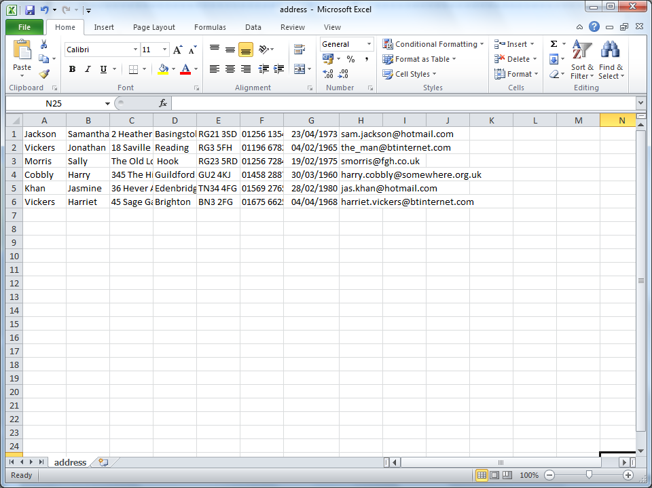
The overview of the .csv file
In the python code, each row will be represented from row[0] to row[7]
The final code would have to be able to split this part into separate values.

Slide 11
The code development
I will only annotate code only when there are differences in the code

Slide 12
Change logs / Development of the code 1-6
Version 1:
The basic version of the code was able to search through the .csv file
Version 2:
The printing of results was more neater, with the additions and use of ‘+i[number]’
Version 3:
Added new variables that define the row numbers
Version 4:
Fixes problem with code not able to search for month in the date
Version 5:
Introduces the use of a routine, which made the code seem simple and much shorter
Also has a loop on the user input
Version 6:
Fixed a large flaw found in the code
*Feedback only shown when code needs improving

Slide 13
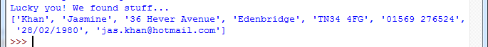
The code Version 1
My first version of the code was able to open the .csv file
It was able to search through the .csv file depending on the input and if there was a match it would output the specific row
The code was simple as you may see in the next slide, and was able to search for anything the user requested to

Slide 14
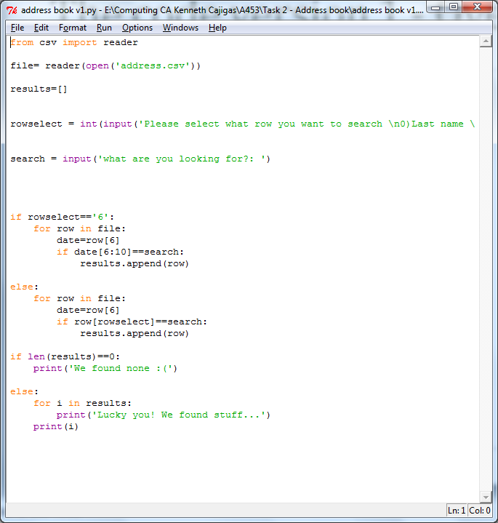
The code version 1 - Overview

Slide 15
The code version 1 - Annotation
The code imports the reader, and defines the variable ‘file’ which opens the .csv file
Allows the user to select the row to search in and to input what the user is searching for
This defines that if the option selected is row 6, then it tells the code that date is in row 6 of the file.
If the length of the list ‘results’ is 0 or empty then it will print the error message.
If there are results found, then it will print that row.

Slide 16
The code version 1 feedback
I thought that my code was able to do the basic requirements for searching in an address book.
However I thought that it needed more additions to it
These included:
Input validation
Cleaner outputs, so it is easier for user to read
Search for month only
Version 2 did not address this, however it did have a cleaner output, where it did not just print the row, it listed what each row was.

Slide 17
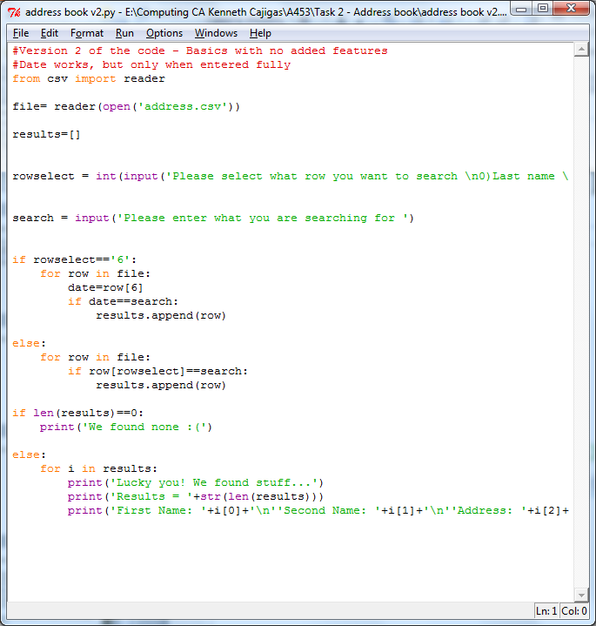

The code version 2

Slide 18
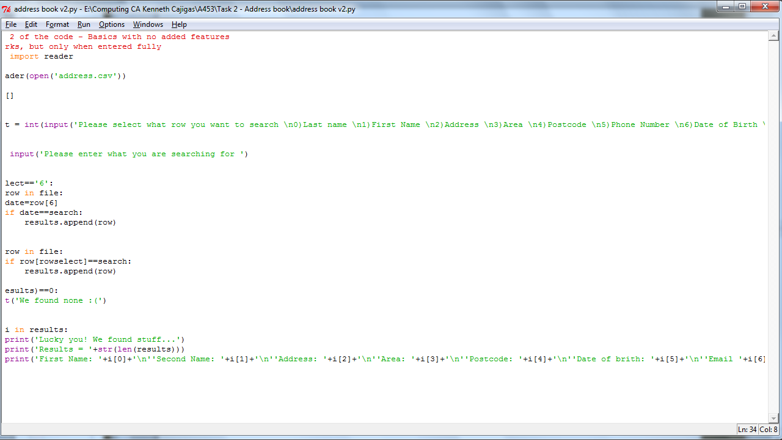
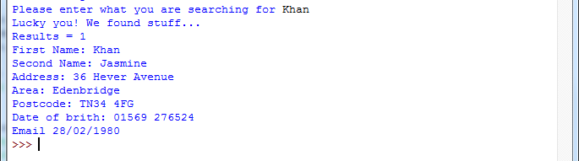
The code version 2 -Feedback
The code was identically the same, however there was a cleaner output with the help of this line:
print('First Name: '+i[0]+'\n''Second Name: '+i[1]+'\n''Address: '+i[2]+'\n''Area:
When a result was found, it printed out like this:

Slide 19
The code version 3
The code version 3 allowed the user to input either option 1 or option 2, instead of the user having to enter the actual row number
It was then reassigned to whatever row number the option selected was.

Slide 20
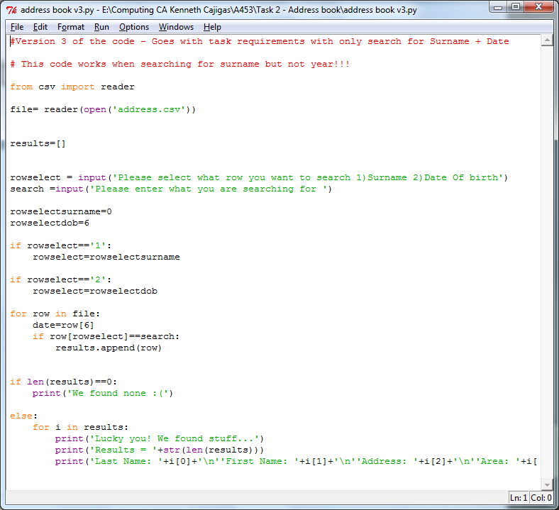
The code version 3 – Overview

Slide 21
The code version 3 - Annotation
As mentioned before, this is where the option selected was reassigned to whatever row it was in

Slide 22
The code version 4 - Overview
The code version 4 was able to finally search for the month the user wishes to search for
This is with the help of the ‘.split’ function.

Slide 23
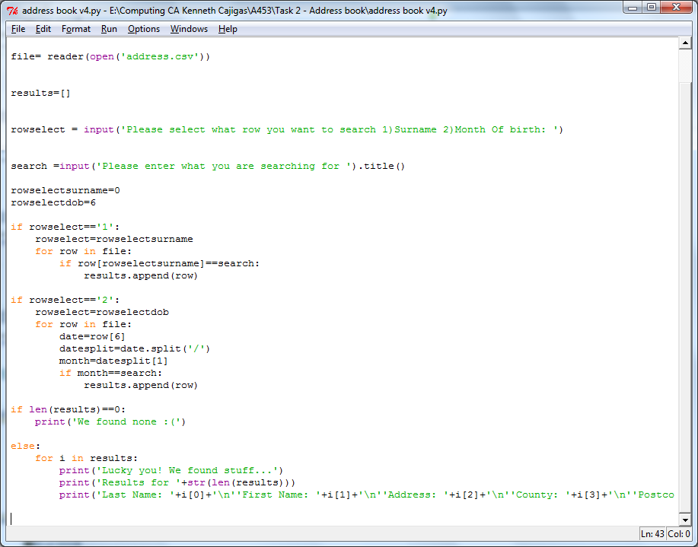
The code version 4

Slide 24
The code version 4 - Annotation
The .split function here helps to split the date into separate values with a ‘/’
I defined here that the month is the datesplit[1]

Slide 25
The code version 5 – BIG Changes
The code version 5 had a big redesign of how I did my code
I started to use the routine function and it finally had a while loop on the input with the help of ‘break’ ‘continue’

Slide 26
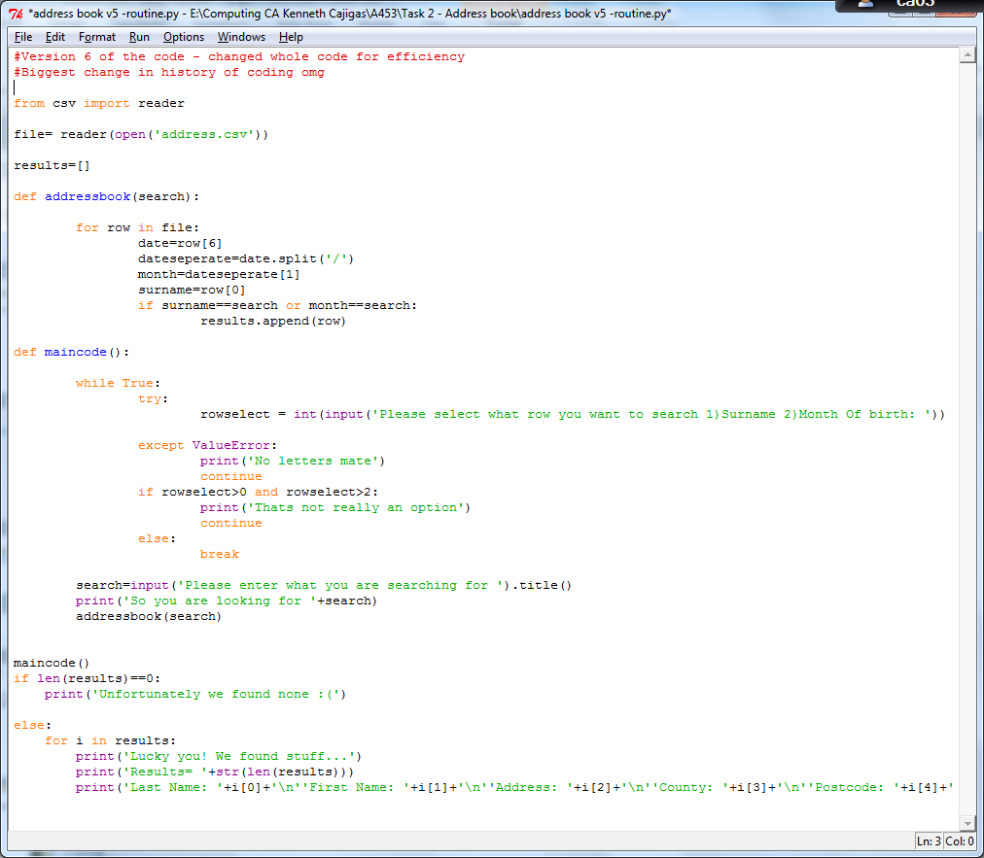
The code version 5 - Overview

Slide 27
The code version 5 - Annotation
The routines here are defined as addressbook and maincode.
The addressbook routine is used after the maincode calls the routine.
maincode() commences the routine to begin
This is where the input is validated, with the different error messages given.
Continue – Continues the loop if the condition is met
Break – Breaks the loop if none of the conditions are met and the input is valid

Slide 28
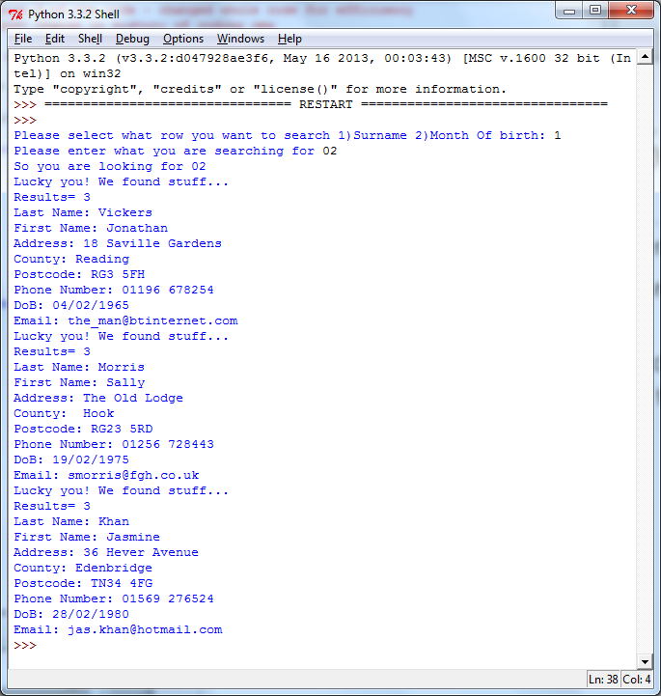
The code version 6 -FINAL
The code version 5 worked, however there was one big flaw.
This was, that no matter what option was chosen (either 1 or 2) it would search.
For example if I chose option 1, which is surname, and enter a month, it will print out the result of the month found anyway.
This can be seen here ->
Therefore, version 6 fixed
this issue and fixed it
Full code can be found in a
text file names ‘Full code’

Slide 29
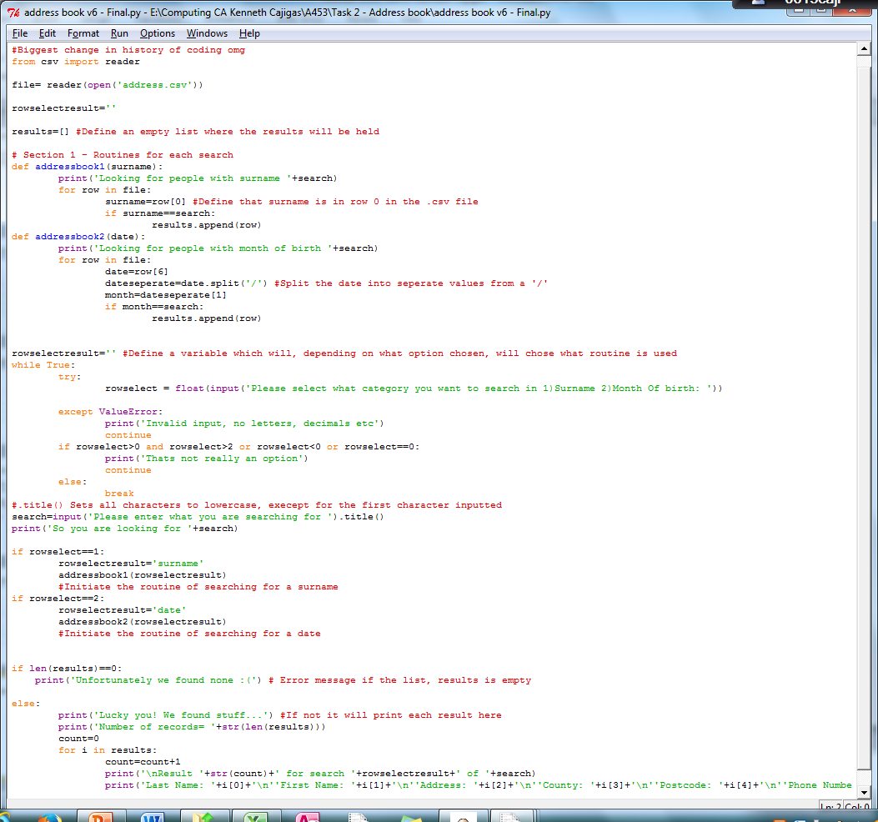
The code version 6 - Overview

Slide 30
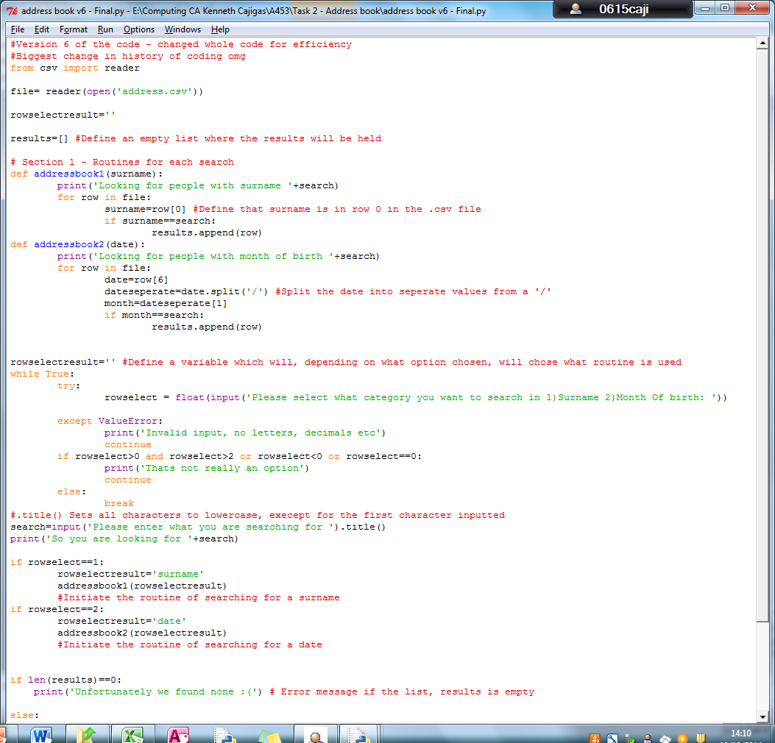
The code version 6 - Annotation
This fixes the issue where no matter what option is chosen it would print out the line. This fixes it.
Notes:
Maybe try explain code in sections!

Slide 31
Testing of the code
The testing of my final code, which changes if needed

Slide 32
The test plan table
Test number Valid/Invalid | Input | Data | Expected outcome
1: Valid | Option ‘2’ 02 | Integer Integer | Should print out 3 results
2: Invalid | Option ‘2’ Khan | Integer String | Should fail with a message ‘Sorry we found none’
3: Valid | Option ‘1’ Jackson | Integer String | Should print out the row with Jackson
4: Invalid | Option ‘101’ | Integer | Should output ‘Sorry that’s not an option’
5: Invalid | Option ‘2’ ‘04’ | Integer Integer | Should output 2 results
6: Valid | Option ‘1’ ‘Ken’ | Integer String | Should output ‘Sorry we found none’

Slide 33
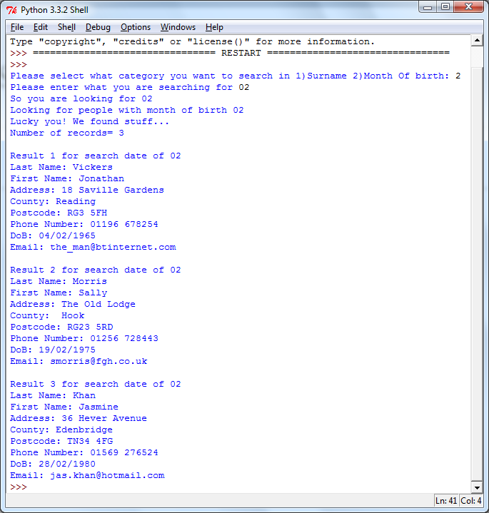
Results:
1: Valid | Option 2 02 | Integer | Should print out 3 results

Slide 34
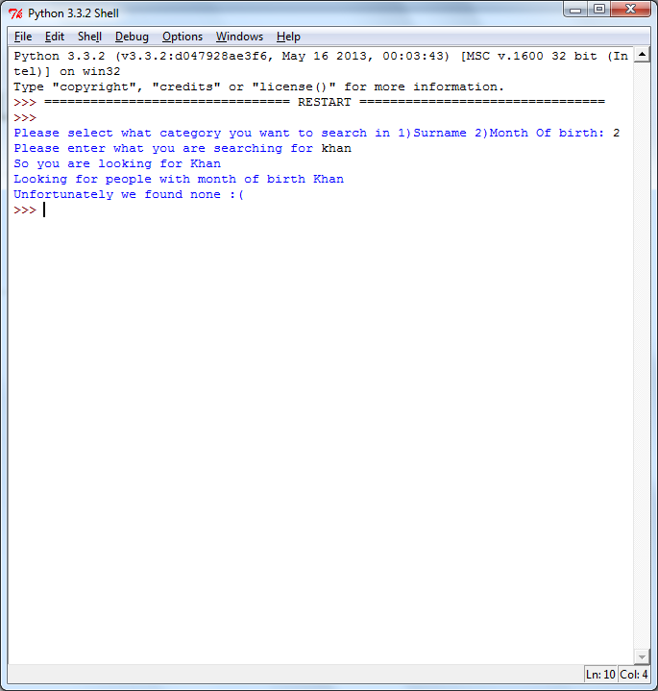
Results:
2: Invalid | Option 2 Khan | String | Should fail with a message ‘Sorry we found none’

Slide 35
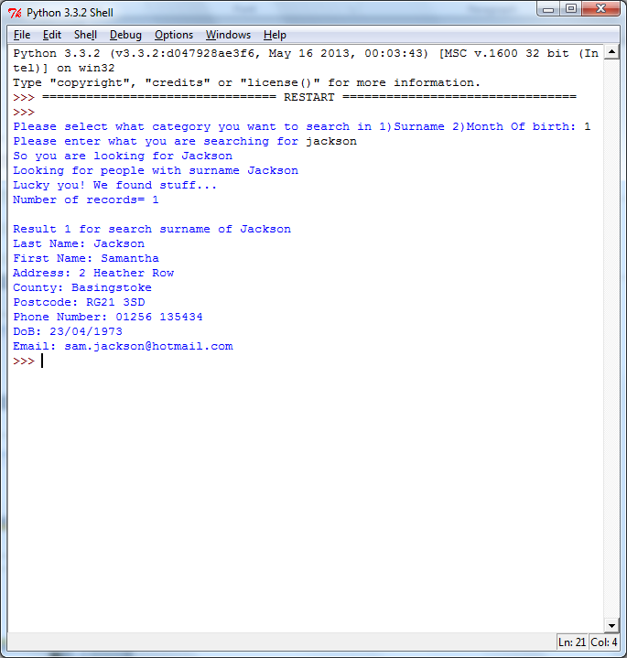
Results:
3: Valid | Option 1 Jackson | String | Should print out the row with Jackson

Slide 36
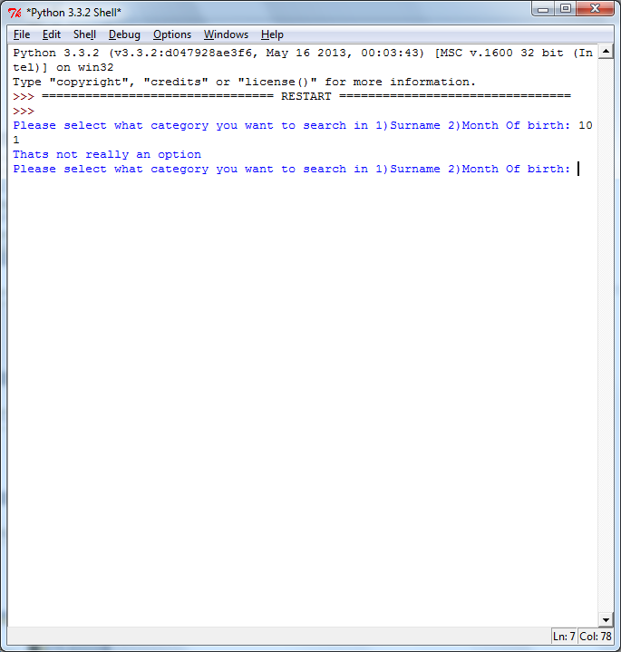
Results:
4: Invalid | Option 101 | Integer | Should output ‘Sorry that’s not an option’ Continue looping

Slide 37
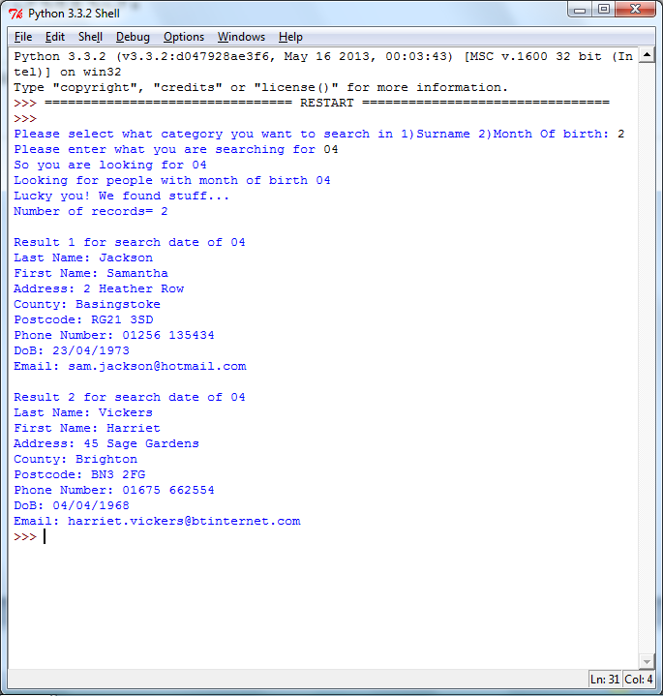
Results:
5: Invalid | Option 2 04 | Numbers | Should output 2 results

Slide 38
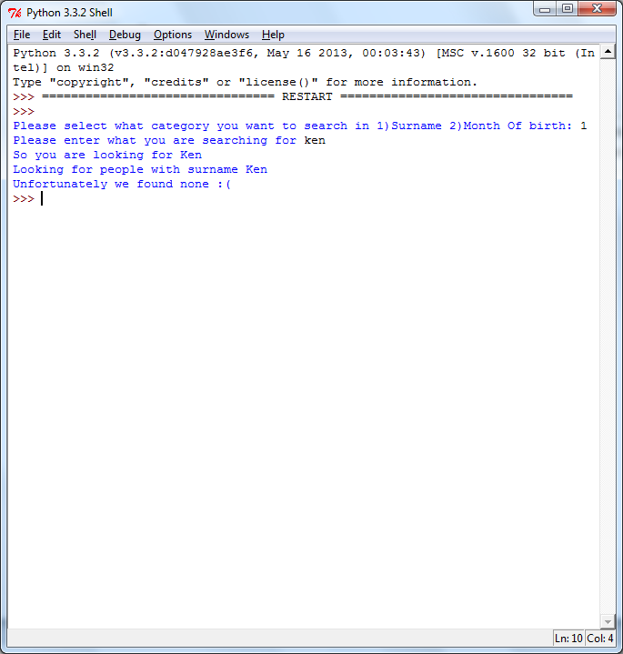
Results:
6: Valid | Option 1 ken | Numbers | Should output ‘Sorry we found none’

Slide 39
In the success criteria that has been set, my code meets:
Yes, my code was able to meet all of the success criteria's that were set before developing the code. These were:
Be able to open a .csv file
Accept and handle an input
Have a verification check to see whether the category to search in is correct and to check if the option entered is valid
Be able to read the .csv file provided
Search inside the .csv file
Output an error message if the input entered by the user doesn’t match the records in the .csv file

Slide 40
ending
Conclusion, Evaluation (Of code)

Slide 41
Evaluation
Overall I feel that I have been able to create a code that is efficient and successful.
I used a variety of functions, and I found that at some points it was challenging, especially when creating a while loop with the input.
It had taken me a while with some research to be able to work out how the while loop and its functions worked.
Thanks to the while loop and its functions, I was able to have verification checks on all my code.

Slide 42
Conclusion
In conclusion I enjoyed creating a code that is efficient and works fully, and is able to search records through a .csv file
I was able to have a verification check on the user input by using a ‘while’ loop.
If I could improve my code, I would try to make it more shorter and efficient as an overall code and also more easy to understand

